Slide 1
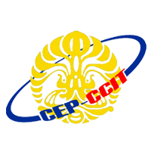
Developed By:
ISAS
Andika saputra
Ugi Ispoyo Widodo
NIIT

Slide 2
DEFINITION OF HARDWARE PC
Physically, the computer consists of several components that constitute system. Systems are components that work together to form a union. If one component is not functioning, it will lead to malfunction of the existing processes with good computer.

Slide 3
TECHNOLOGY ARCHYTECTURE
OF
MOTHERBOARD
START DATE
27th August 2015
NAME OF COORDINATOR
Mrs. Emma Yulianti, ST, MM
DATE OF SUBMISSION
08th September 2015
END DATE
05th September 2015
CLASS
3SC4
GROUP NUMBER
10

Slide 4
DEFINITION OF MOTHERBOARD
A motherboard is one of the most essential parts of a computer system. It holds together many of the crucial components of a computer, including the central processing unit (CPU), memory and connectors for input and output devices.

Slide 5
COMPONNENTS OF MOTHERBOARD AND FUNCTIONS
Chipset (Southbridge & Northbridge)
CPU Socket
PCI Slot
AGP Slot
Memory Slot
Heat Sink (Active & Passive)
Power Connector
SerialATA (SATA) slot
Primary And Secondary IDE slot
BIOS
CMOS
Capacitors

Slide 6
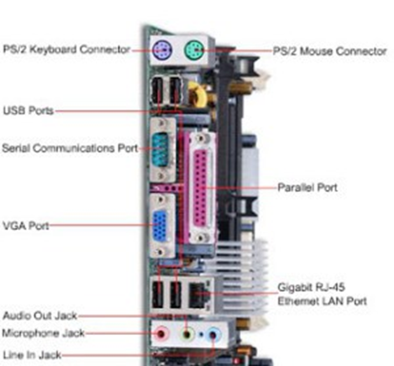
PORTS OF MOTHERBOARD AND FUNCTIONS
Serial Port
Parallel Port
PS / 2 Ports
Sound Card Port
USB Port
VGA Port
LAN Port
HDMI Port

Slide 7
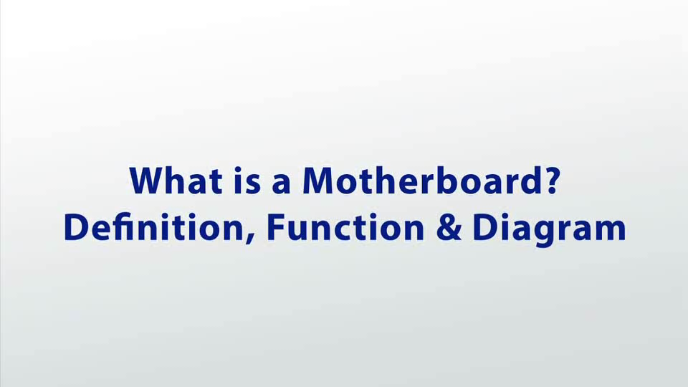
video

Slide 8
CONCLUSIONS AND SUGGESTIONS
Of the subject that has been the authors discussed, the authors conclude that the motherboard is one of the technology architecture that plays an important role today.
And we recommend that, when buying the PC motherboard you must be smart in choosing, and in accordance with the budget and purposes, given the concomitant development of the times, motherboard or PC hardware getting more updated and sophisticated course.

Slide 9


Thank
you

